Slide 1

SecureSoft Compliance Auditor
In the era of rapid software development and increasing cyber threats, the integration of security into the DevOps lifecycle—commonly known as DevSecOps—has become imperative. This project presents SecureSoft Compliance Auditor, a unified, automated security platform designed to bridge the gap between development velocity and stringent security requirements.

Slide 2
Introduction & Context
1.1 Background: Digital Transformation & Regulations
1.2 Motivation: Bridging the Tooling Gap
Existing security tools are either basic CLI utilities lacking visibility (e.g., grep, Trivy) or expensive, complex enterprise suites (e.g., SonarQube, Checkmarx). We need a middle-ground: an easy-to-deploy, GUI-driven tool with robust, automated scanning.
The digital transformation has vastly increased sensitive data processing, leading to stringent regulations like GDPR (€20M or 4% turnover penalty) and HIPAA. Simultaneously, Agile and DevOps prioritize speed, often pushing security to an afterthought and creating friction.
1.3 Objectives: SecureSoft Compliance Auditor
1.4 Scope of Work: End-to-End Development
Hybrid scanning for hardcoded secrets & PII in real-time.
Frontend: Responsive web application (Next.js).
Unified dashboard, statistics rich insightful reports.
Backend: RESTful API for logic & requests (.NET 8).
Automated and scheduled execution of all kind of scan and report generation.
Database: Relational DB for data, history, rules.
Infrastructure: Docker for isolating scan processes.
Scalability via asynchronous background jobs for large codebases.

Slide 3



Review of Literature: SAST Evolution & Gaps
2.1 Evolution of SAST
2.3 Research Gaps
Static Application Security Testing (SAST) has evolved from simple lexical analysis to complex Abstract Syntax Tree (AST) analysis.
Academic research often neglects usability and workflow integration for non-security experts. There's a gap in tools that translate technical findings (e.g., "Line 40: AWS_ACCESS_KEY found") into clear business risks (e.g., "Critical: GDPR Violation - Unsecured Credential Storage") automatically. SecureSoft aims to fill this critical gap.
Studies show modern tools catch more bugs but suffer from high false-positive rates (up to 40%), leading to developer fatigue. Context-insensitive tools often miss data flow vulnerabilities.
2.2 Comparative Analysis of Existing Tools
Feature
SecureSoft (Proposed)
SonarQube
Trivy
Manual Review
Interface
Web Dashboard (GUI)
Web Dashboard (GUI)
CLI (Terminal)
N/A
Setup Complexity
Low (Docker/Exe)
High (Requires DB/JVM)
Low (Single Binary)
N/A
Real-time Feedback
Yes (Polling API)
No (Batch Scans)
No
No
Compliance Mapping
Native (GDPR/HIPAA)
Plugin Required
Limited
High Effort
Scanning Depth
Hybrid (Regex + AST)
Deep (AST)
Shallow (Vuln DB)
Very Deep
Cost
Free / Open Source
Enterprise License
Open Source
Expensive (Labor)

Slide 4
Problem Statement: Bridging the Gap
"How can organizations bridge the gap between rapid software development and stringent security compliance without hindering developer productivity?"
Specific sub-problems include:
Latency
Traditional scans take hours; developers need minutes.
Visibility
Managers cannot easily see the "compliance health" of a project from CLI logs.
Actionability
Generic error messages do not explain how to fix a security flaw.

Slide 5
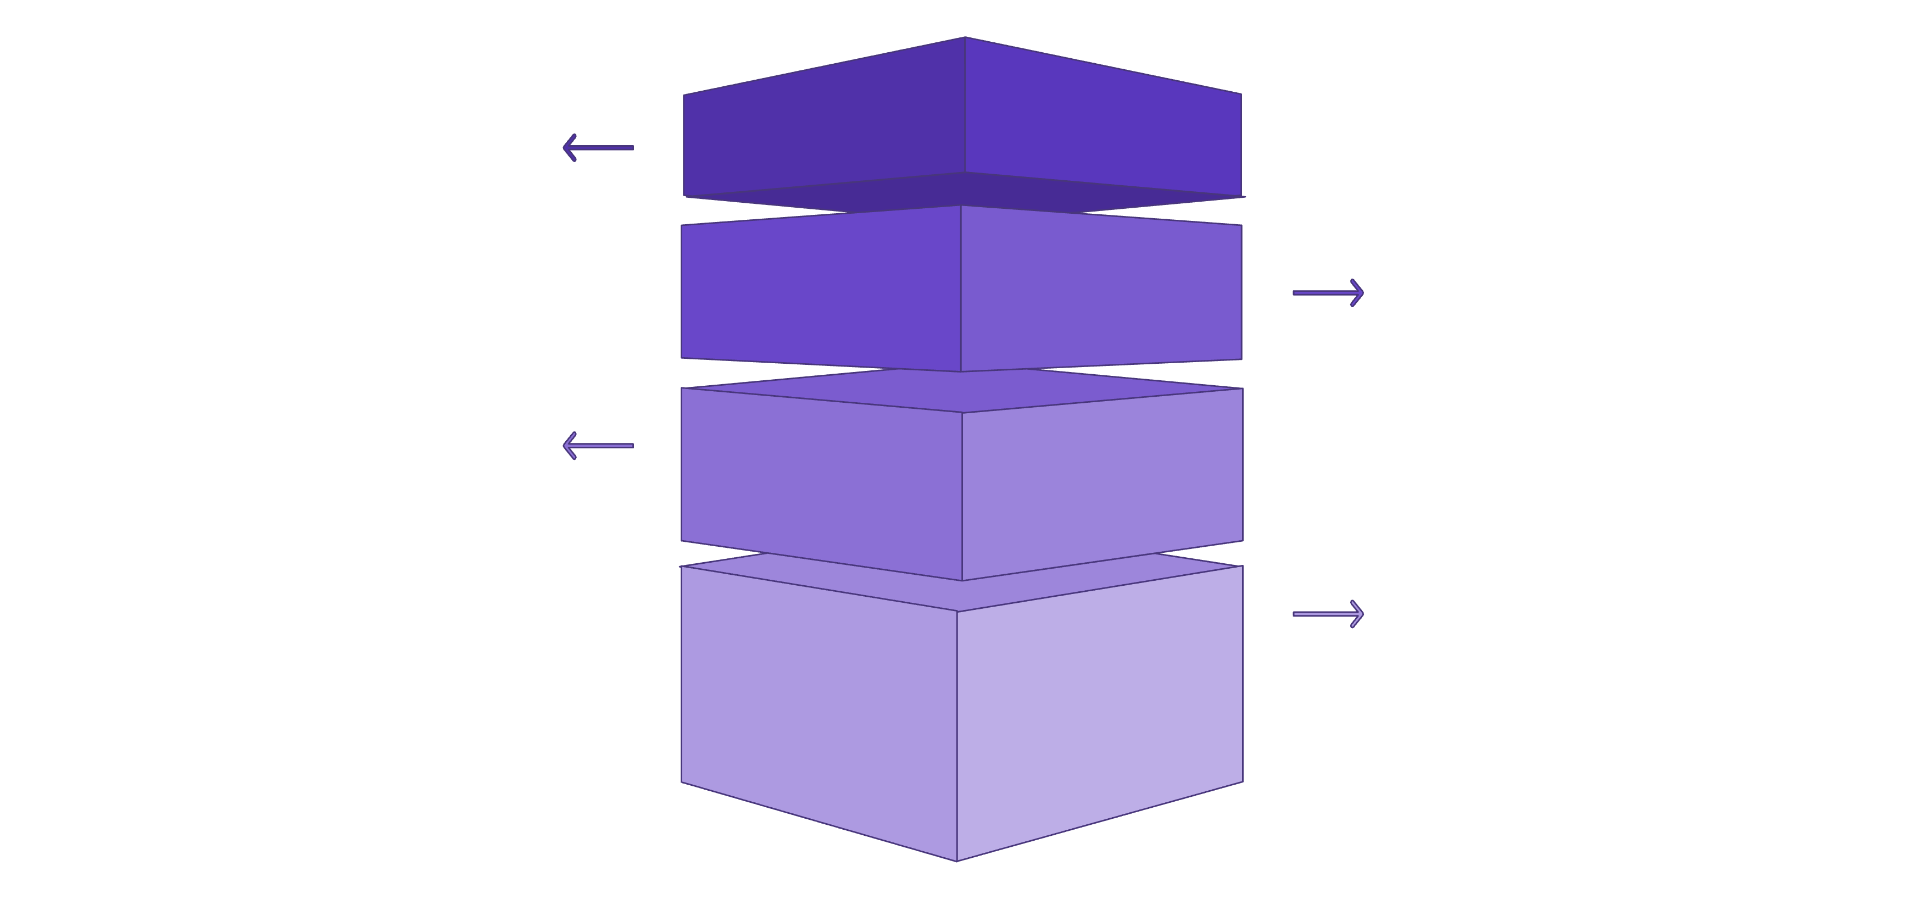
System Design & Architecture
4.1 High-Level Architecture: Service-Oriented Approach
The system utilizes a Service-Oriented Architecture (SOA) to ensure a clear separation of concerns and modularity across its components.
Client Layer
User Browser and Next.js frontend interacting with APIs.
Application Layer
ASP.NET Core API, Auth Service (JWT), and Hangfire job manager.
Data Layer
SQL Server database and local file system storage.
Execution Layer
Validation engine orchestrates Docker container for Privado.

Slide 6
Technology Stack & Database Schema
4.2 Technology Stack
4.3 Database Schema Design
Frontend:
The database is normalized to 3NF, ensuring data integrity and efficient storage.
Framework: Next.js 14 (React 18)
erDiagram
USERS ||--o{ REPORTS : "owns"
USERS ||--o{ SCAN_PROGRESS : "initiates"
REPORTS ||--|{ VIOLATIONS : "contains"
USERS {
uuid Id PK
string Username
string PasswordHash
string Email
} ....
Styling: Tailwind CSS
State Management: React Context API
Visualization: Chart.js / Recharts
Backend:
Framework: ASP.NET Core 8.0
Language: C#
ORM: Dapper (performance) & Entity Framework Core (schema)
Background Jobs: Hangfire
Database:
Microsoft SQL Server 2022
Security:
BCrypt Hashing for passwords
JWT (RS256) for API authentication

Slide 7
Methodology & Implementation: Core Modules
5.1 Core Modules
5.1.1 Authentication Module
5.1.2 The Hybrid Scan Engine
SecureSoft employs a stateless authentication mechanism. Upon successful login, the server issues a JSON Web Token (JWT), securely stored in an HttpOnly cookie to prevent Cross-Site Scripting (XSS) attacks.
The core innovation is our hybrid engine, combining two distinct paths:
Fast Path (Regex): Immediate detection of simple patterns like email addresses or IP addresses.
Slow Path (AST/Docker): For complex logic, spawning Docker containers (Privado or Semgrep) to mount target volumes, run deep scans, and parse JSON output.

Slide 8


Algorithms & Workflow
Luhn Algorithm (Credit Card Validation)
Asynchronous Job Scheduling
To reduce false positives for credit card numbers, the system applies the Luhn checksum algorithm, ensuring numerical validity.
For long-running scans, we utilize the Producer-Consumer pattern via Hangfire:
Producer: API pushes a ScanJob to a persistent queue.
Consumer: Background worker executes the scan, updating ScanProgress.
public static bool IsValidCreditCard(string number) {
int sum = 0; bool alternate = false;
for (int i = number.Length - 1; i >= 0; i--) {
int n = int.Parse(number[i].ToString());
if (alternate) { n *= 2; if (n > 9) n = (n % 10) + 1; }
sum += n; alternate = !alternate;
} return (sum % 10 == 0);
}
Observer: Frontend polls ScanProgress every second for UI updates.
5.3 Workflow Diagram (Scan Lifecycle)

Slide 9

Results and Discussion
6.1 Performance Evaluation
Testing against a ~50MB Node.js project (2000 files) revealed significant efficiencies.
90%
1.2s
45s
Time to Value Reduction
Regex Scan Time
Full Scan Time
From intent to readable report, time is cut by 90% due to automation.
Fast Path scan completion on average.
End-to-end deep analysis with minimal overhead.
6.2 Functional Verification
Secret Detection
GDPR Compliance
Concurrency
Successfully identified AWS Access Keys and Stripe Secret Keys in config files.
Correctly flagged exposed Email addresses and Phone numbers in user data.
System handled 5 simultaneous users without crashing, thanks to Hangfire.
6.3 Comparison with Market Standards
Unlike SonarQube, which demands 4GB+ RAM and a dedicated server, SecureSoft runs comfortably on a standard developer laptop (500MB RAM footprint), making it ideal for individual developers and SMEs.

Slide 10

Conclusion and Future Scope
7.1 Conclusion
7.2 Future Scope
SecureSoft Compliance Auditor proves robust security auditing doesn't need complex, expensive infrastructure. By blending modern web tech with efficient background processing, we created a powerful, accessible tool. It meets all objectives, offering a seamless "Click-to-Scan" experience that integrates compliance into daily developer workflows.
AI-Powered Remediation: Integrate LLMs to suggest code fixes automatically.
IDE Plugins: Develop extensions for VS Code/IntelliJ for real-time feedback during coding.
Cloud Storage: Migrate report storage to Azure Blob Storage for enterprise scalability.
CI/CD Integration: Create GitHub Actions/Azure DevOps tasks to block PRs if compliance scores drop.
References
General Data Protection Regulation (GDPR). (2018). Official Journal of the European Union.
Charoenwet, W., et al. (2024). “An Empirical Study of Static Analysis Tools for Secure Code Review”. ACM SIGSOFT.
Li, K., et al. (2023). “Comparison and Evaluation on Static Application Security Testing (SAST) Tools”. ESEC/FSE ’23.
Microsoft. (2025). "ASP.NET Core Performance Best Practices". Microsoft Documentation.
OWASP Foundation. (2024). “OWASP Top 10 Security Risks”.

